Slide 1
UI – HTML/CSS/BS

Slide 2
HTML documents
HTML (HyperText Markup Language) documents are the core of the web, used to structure and present content on the internet.
It has the following:
Document Declaration :<!DOCTYPE html>
HTML Root Element : <html></html>
Head Section : <head>....</head>

Slide 3
Using doctype
What is DOCTYPE : <!DOCTYPE html> tells the browser that the page is written using the HTML5 standard, which helps it render the page correctly.

Slide 4
The head element
The <head> element in HTML is a container for metadata (data about the HTML document) and links to external resources. It is placed at the beginning of an HTML document, before the <body> element. The content inside the <head> is not directly displayed on the webpage but is essential for the functionality, appearance, and search engine optimization (SEO) of the page.

Slide 5
Using <head>
The <head> element in HTML is a container for metadata and links to external resources. It is placed within the <html> document structure, immediately after the opening <html> tag and before the <body> tag.
Purpose of the <head> Element :
The <head> element provides information about the document that doesn't appear directly on the webpage. It includes metadata, styles, scripts, and other resources required for the webpage.
Common Elements Inside <head>
<title>, <meta>, <link>, <style>, <script>, <base>

Slide 6

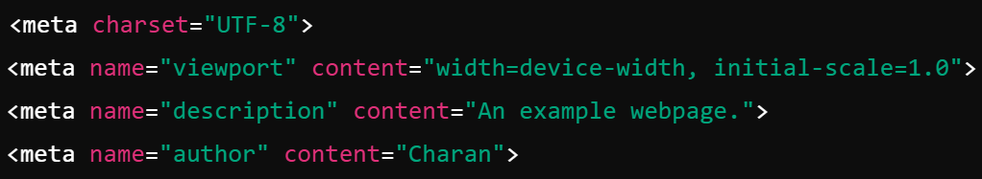

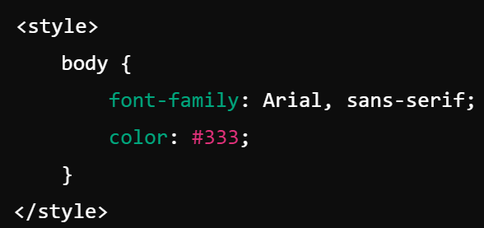
Using <head>
<title> --> Specifies the title of the html plage
<meta> --> Provides the meta information.
Link : Provides external stylesheet reference.
<style> --> Providesthe style fo the html

Slide 7
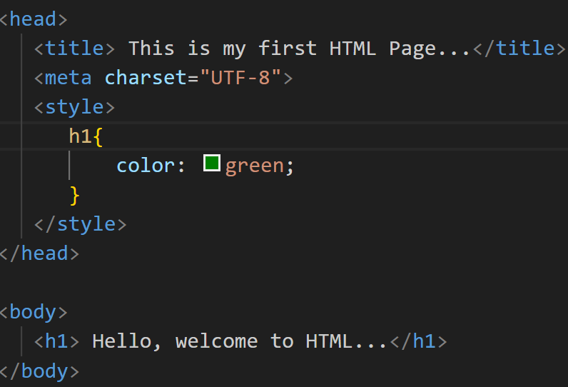
Using <head>

Slide 8
The body element
The <body> element in HTML represents the content of the document that is visible to the user in the web browser. It is one of the core elements in an HTML document and is used to define everything that should appear as part of the webpage, such as text, images, videos, forms, links, and other interactive elements.

Slide 9
Using id and class attributes
The id and class attributes in HTML are used to define and target elements for styling, scripting, or other purposes.

Slide 10
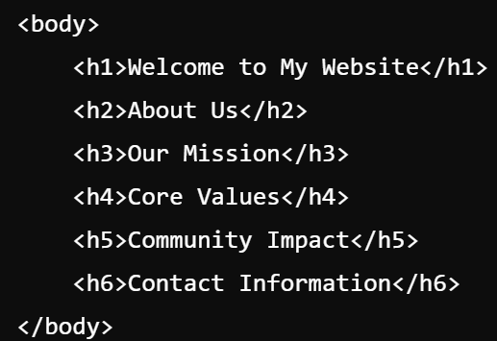
HTML Text - Headings
HTML headings are essential elements used to structure and organize the content of a webpage. They range from <h1> to <h6>, where <h1> is the highest level (most important) heading, and <h6> is the lowest level (least important).

Slide 11
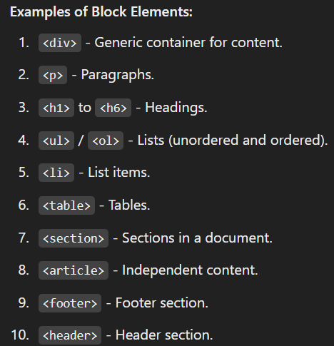
HTML Text - Block and Inline Elements
In HTML, elements are categorized into block elements and inline elements based on their behavior and rendering on the web page.
Block Elements : Block elements take up the full width of their container and always start on a new line.
Features: Creates a block-level box. Can contain other block elements or inline elements. Useful for structuring the layout of the webpage.

Slide 12
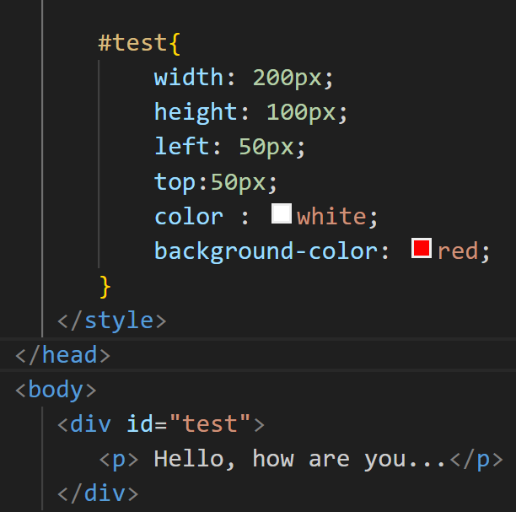
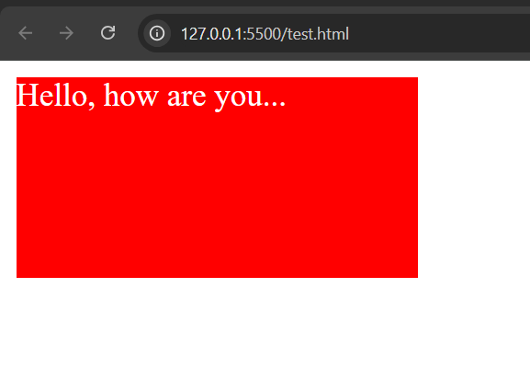
HTML Text - Block and Inline Elements
Div bloc :

Slide 13
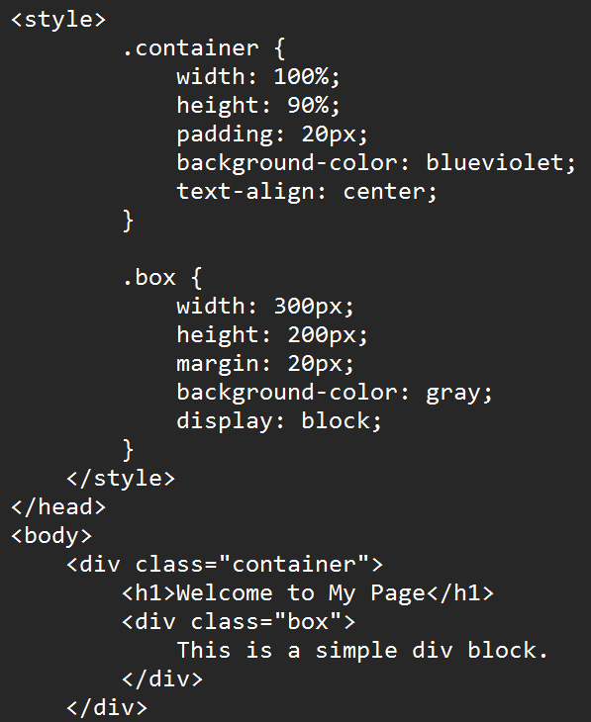
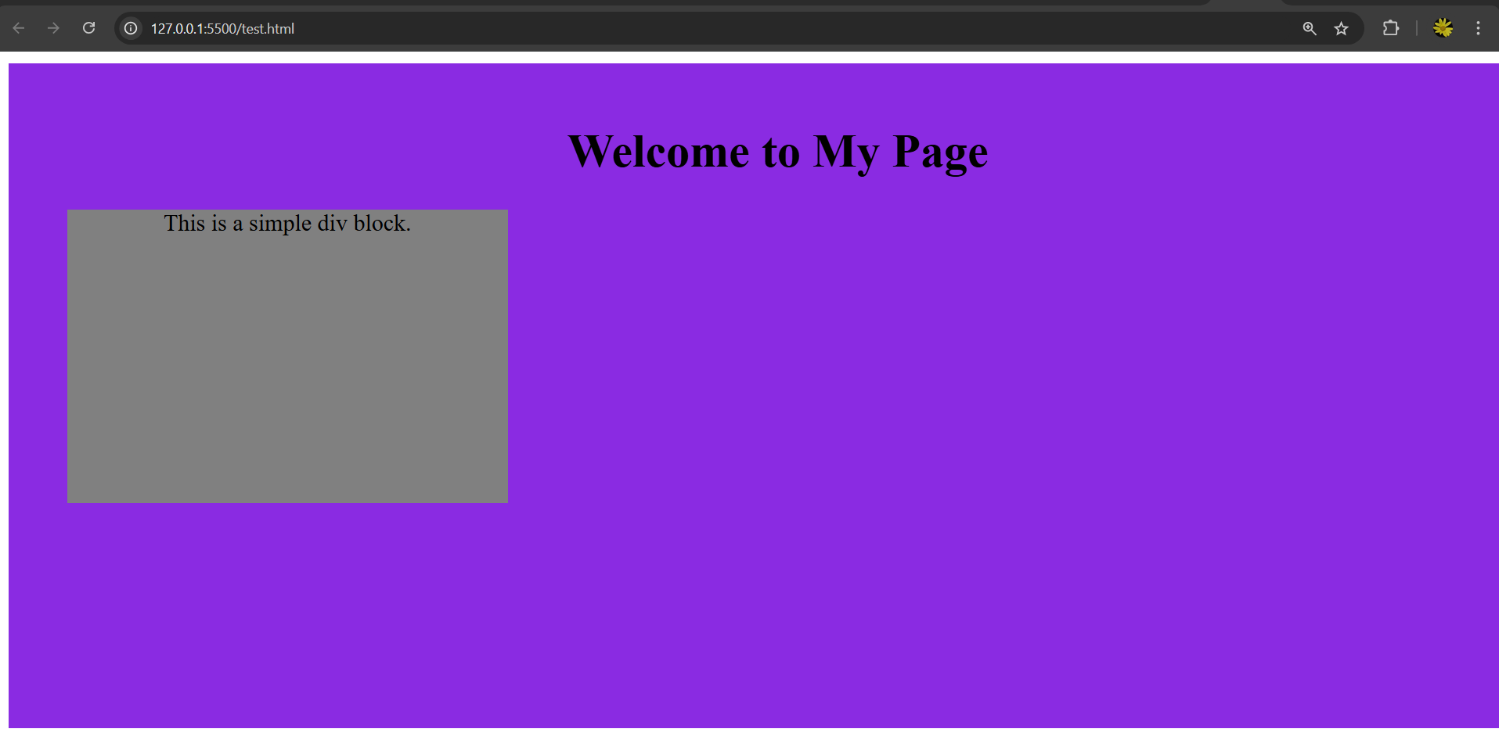
HTML Text - Block and Inline Elements
Another Div block example :

Slide 14
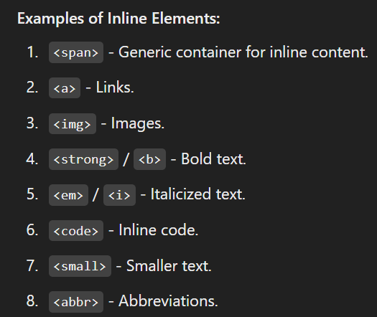
HTML Text - Block and Inline Elements
Inline Elements : Inline elements only take up as much width as necessary and do not start on a new line.

Slide 15
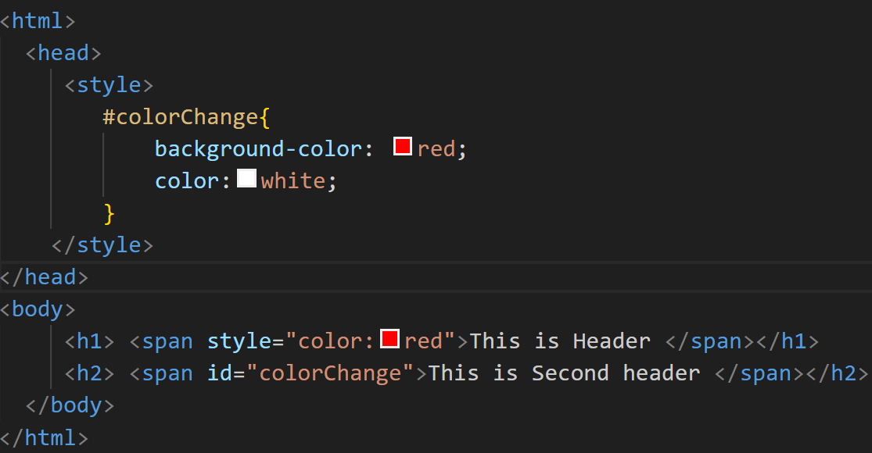
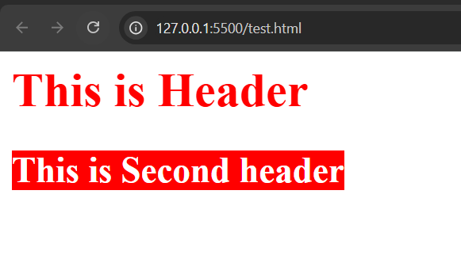
HTML Text - Block and Inline Elements
<span> -- The <span> element in HTML is an inline container used to group or style text or inline elements. It does not inherently affect the layout or presentation of the document unless styled with CSS.

Slide 16
HTML Lists - List Types
There are two types of lists.. They are
Ordered List
Unordered List.
Definition List.

Slide 17
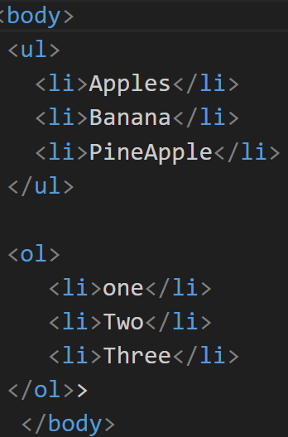
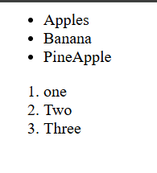
Creating Lists
Creating ordered and
unordered list.

Slide 18
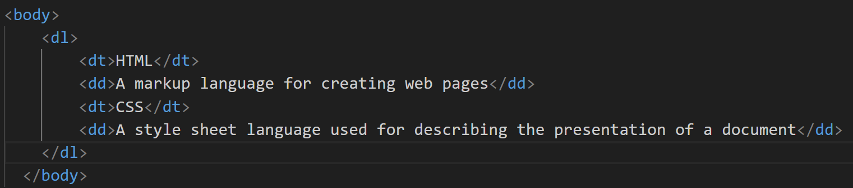
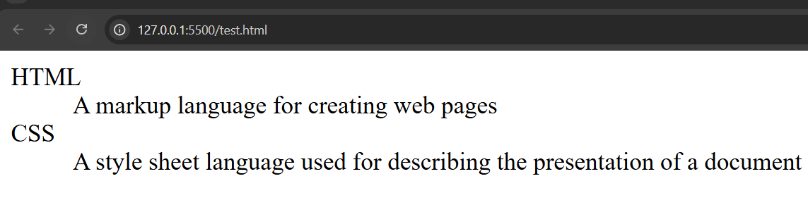
List Rendering
Previous example can used for UL and OL.

Slide 19
HTML Links - Link concepts.
HTML Links
HTML links are created using the <a> (anchor) element, which is used to define hyperlinks that allow users to navigate between different pages or sections within a page or external sites.
Link Concepts : A link in HTML is typically created with the <a> element, which stands for "anchor". The anchor element allows you to link to other web pages, files, or specific parts of a page. The href attribute in the <a> tag specifies the destination of the link.

Slide 20
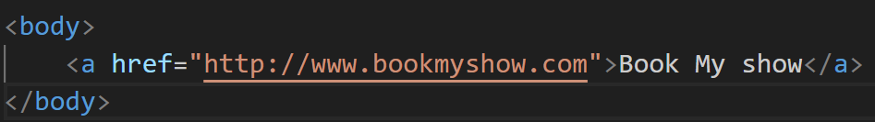
Linking Documents
Linking Documents
You can link to external documents or pages (like HTML files, PDF documents, or other resources) by providing the appropriate URL in the href attribute.

Slide 21
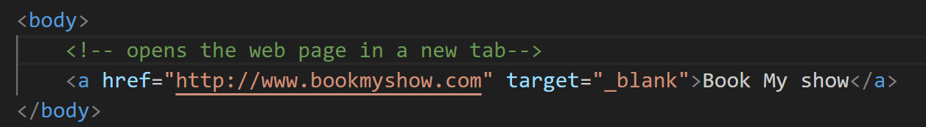
Understanding Targets
he target attribute in the <a> tag is used to specify where the linked document will open when the link is clicked. By default, links open in the same window or tab, but you can control this behavior with different values for the target attribute.

Slide 22
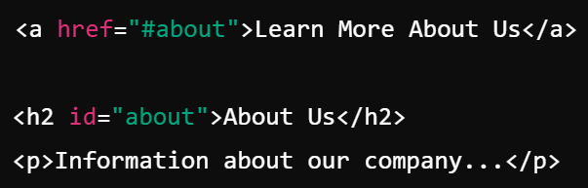
Linking to Targets
Linking to Targets
You can link to specific sections or elements within the same document or other documents. This is typically done using anchor links, which reference an element with a specific id attribute.

Slide 23
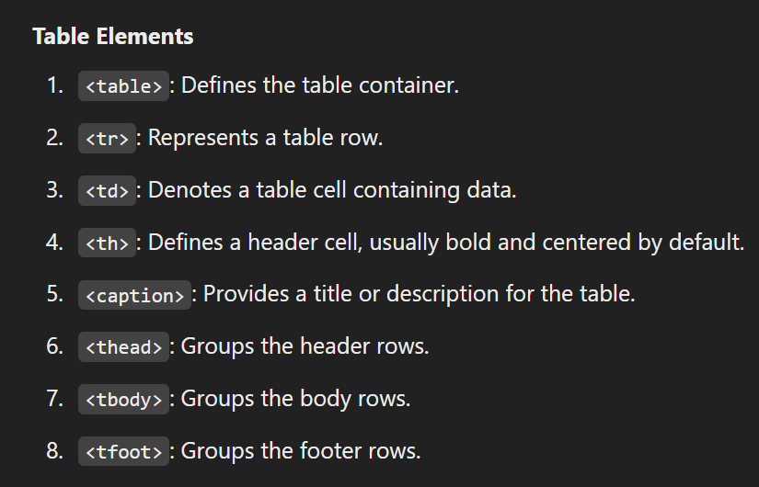
HTML Tables -Table Elements
HTML Tables : HTML tables are used to organize and display data in a tabular format consisting of rows and columns.

Slide 24
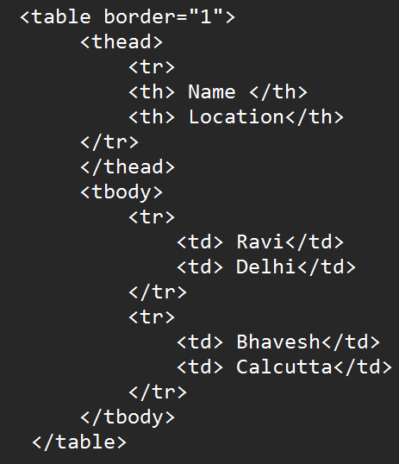
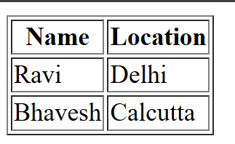
Structuring a Table
A well-structured table typically includes:
Table headers (<th>) for column or row titles.
A table body (<tbody>) for main data rows.
Optional header (<thead>)

Slide 25
Table Data
Table Data
Cell content: Insert text, images, or even other HTML elements inside <td> or <th>.
Alignment: Adjust alignment using text-align and vertical-align properties in CSS.

Slide 26
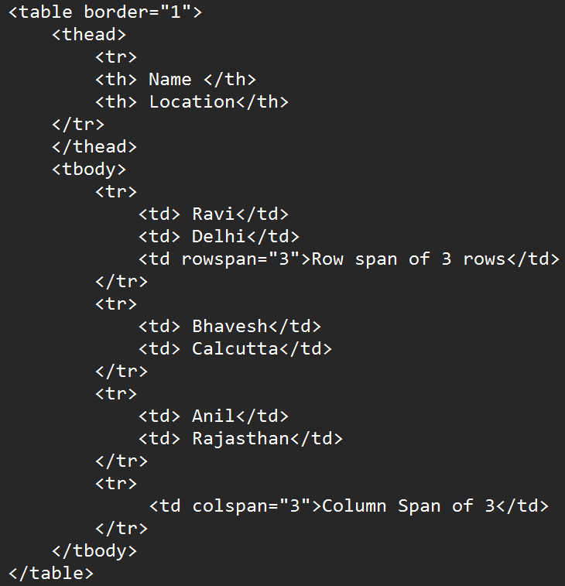
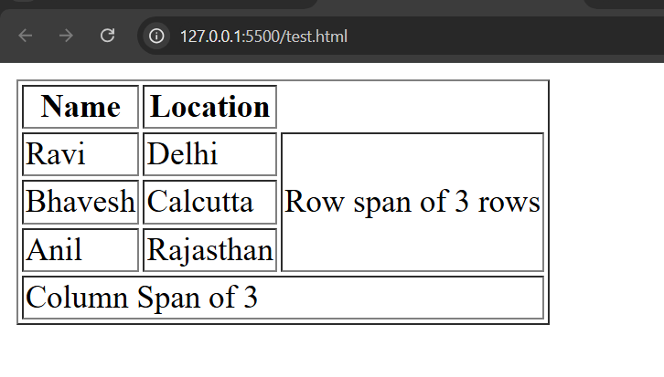
Spanning Columns and Rows

Slide 27
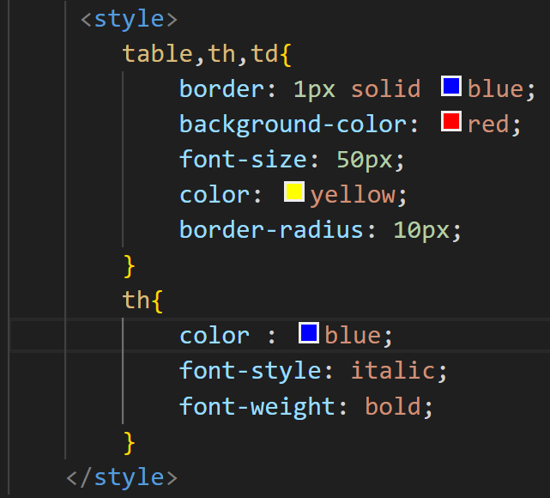
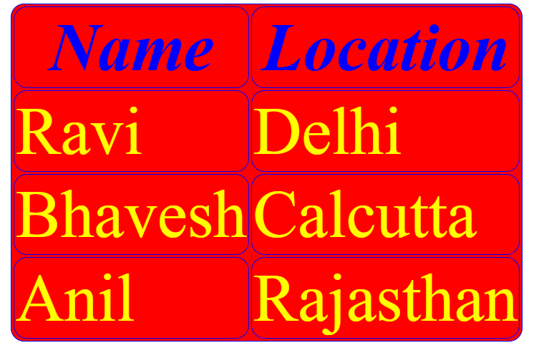
Formatting Tables
Adding styles for the table will give the following output

Slide 28
HTML Images and Objects - Image and Object Concepts
Image and Object Concepts
Images (<img>):
Used to display pictures, icons, or other raster/vector graphics.
Supports formats like JPG, PNG, GIF, SVG, and WEBP.
Lightweight and essential for visual enhancement of web pages.
Objects (<object>):
Used to embed multimedia content (e.g., PDFs, videos, or applets) or interactive content.
Provides fallback content if the object cannot be rendered.

Slide 29
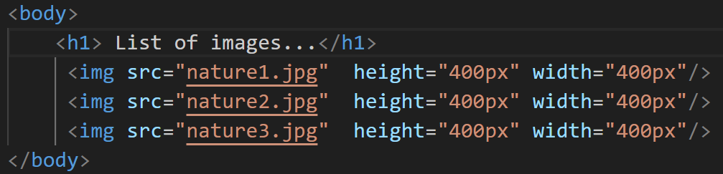
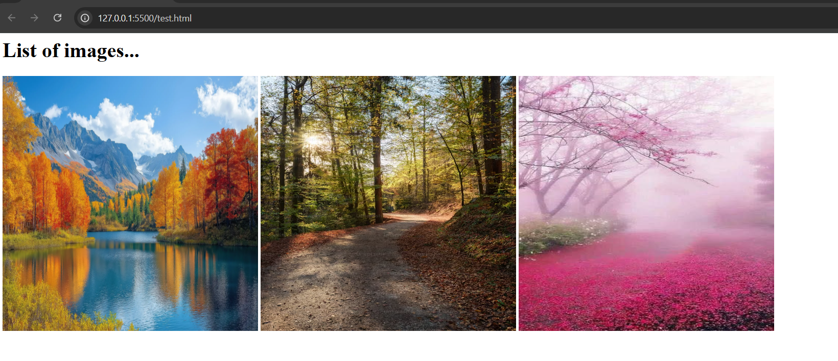
Adding Images

Slide 30
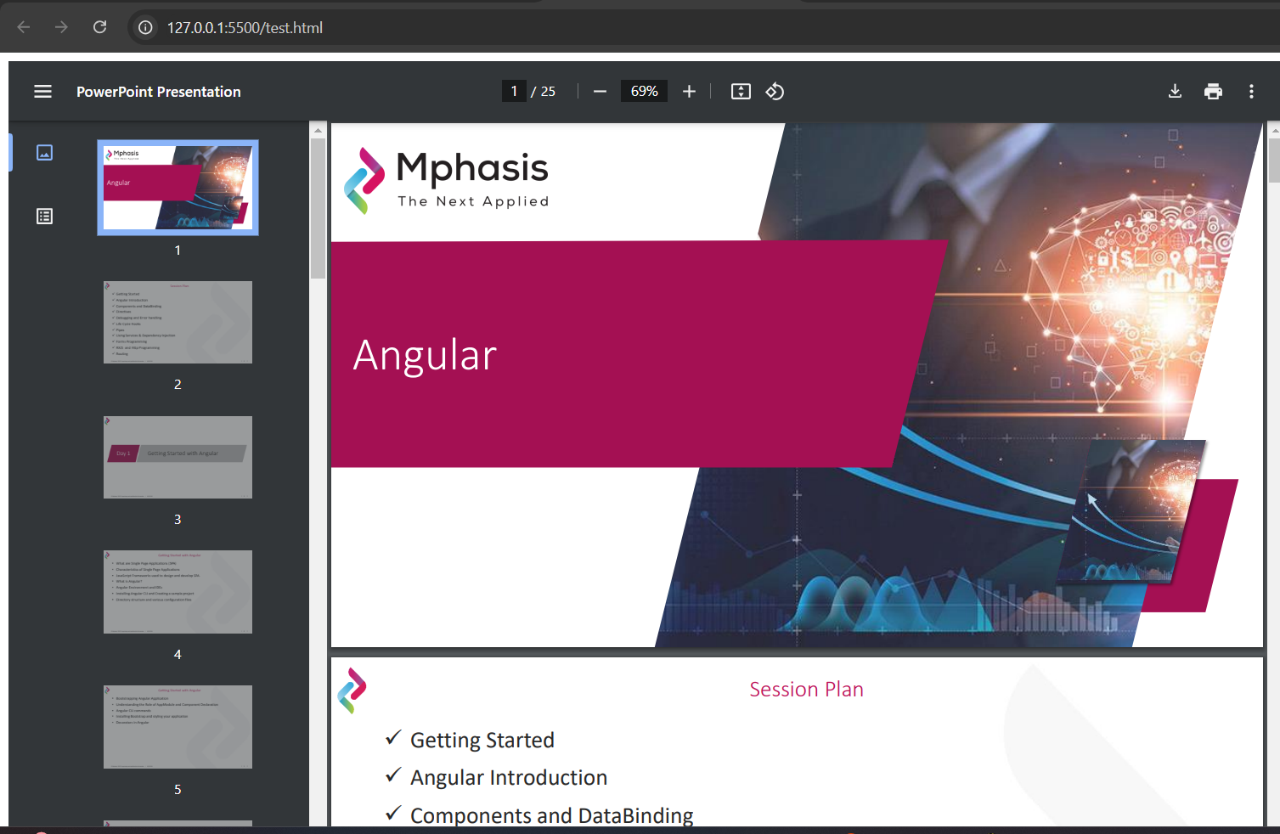
Adding Objects

Slide 31
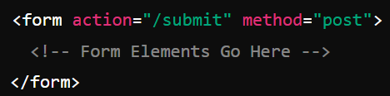
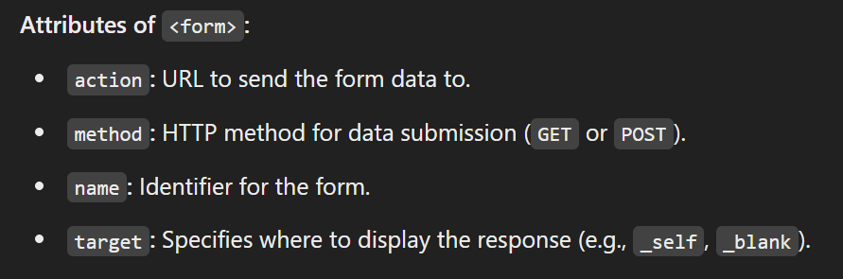
HTML Forms - HTML forms fundamentals
HTML forms are used to collect user input and send it to a server for processing. They are essential for creating interactive web applications like login pages, surveys, and registration forms.

Slide 32
Form Basics
Commonly used form controls:
Text Input
Password Input
Checkbox
Radiobutton
Dropdown
Text Area
Submit Button.

Slide 33


Form Settings
Following can be given in the form as setting.
Required :
File uploads :
Hidden Inputs :
Place Holders :
Reset form :

Slide 34
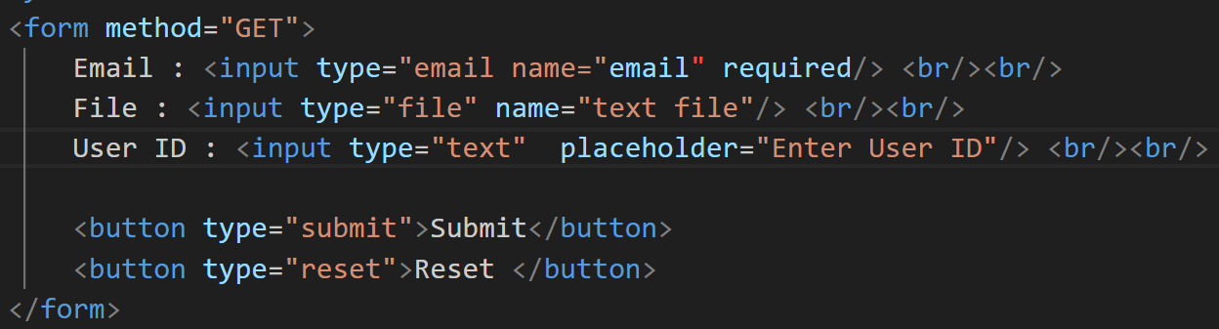
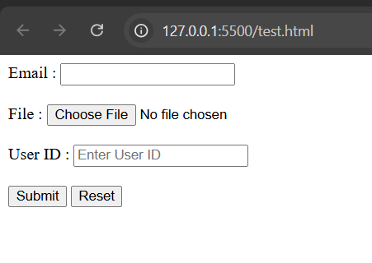
Form Settings

Slide 35
HTML form input - Text inputs
HTML form inputs provide a way for users to interact with a webpage and submit data.
Single Line Input :
Password :
Email :
Number :

Slide 36
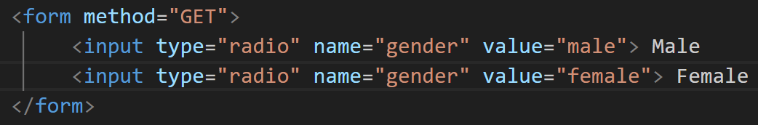
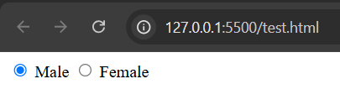
Selections
The selections are (a) Radiobutton (b) Checkbox (c) Drowndown and (d) Multi Select Dropdown.
Radiobutton

Slide 37
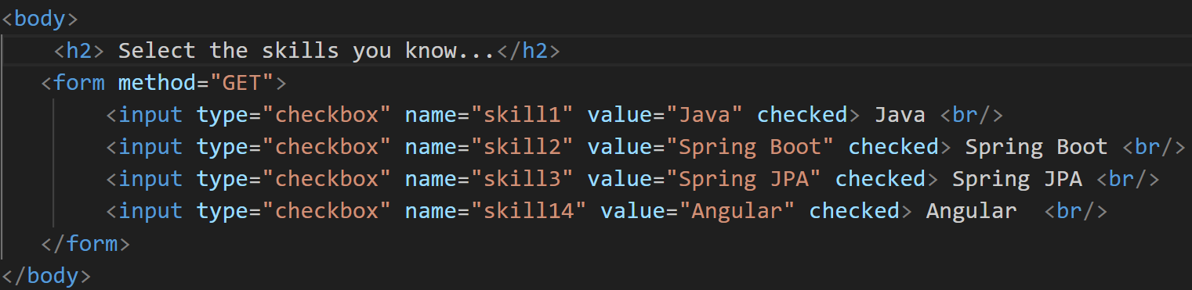
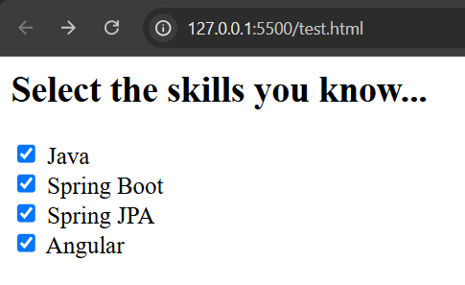
Selections
Checkbox

Slide 38
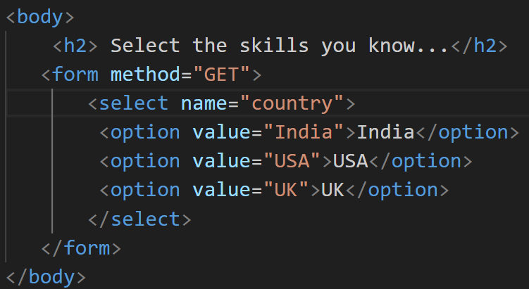
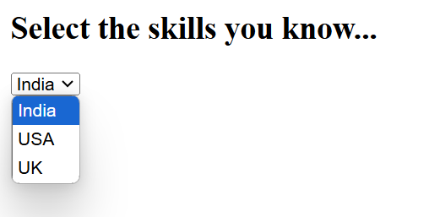
Selections
Choice :

Slide 39
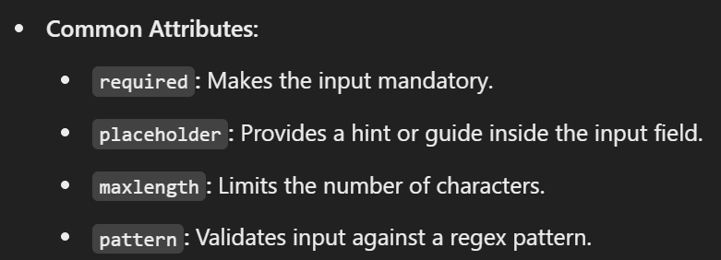
Input attributes.

Slide 40
Input commands.
Submit button
Reset Button
File uploads
Hidden data.

Slide 41
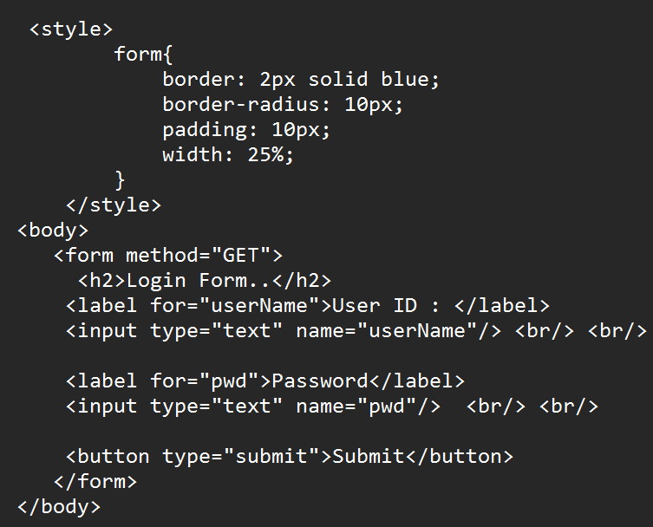
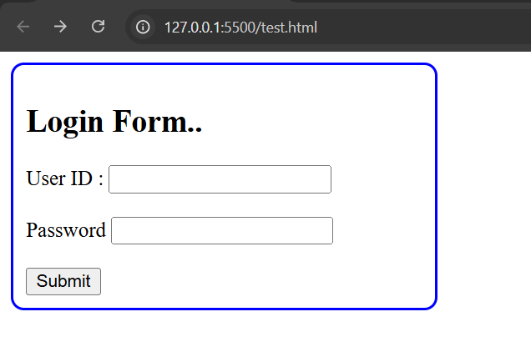
Labels
Used to associate descriptive text with form inputs.

Slide 42
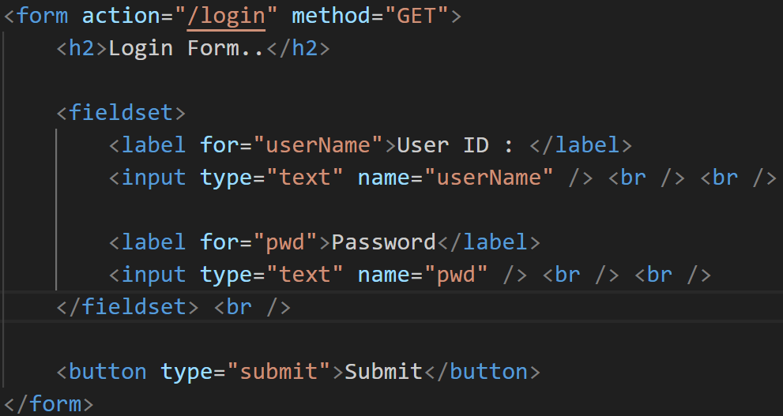
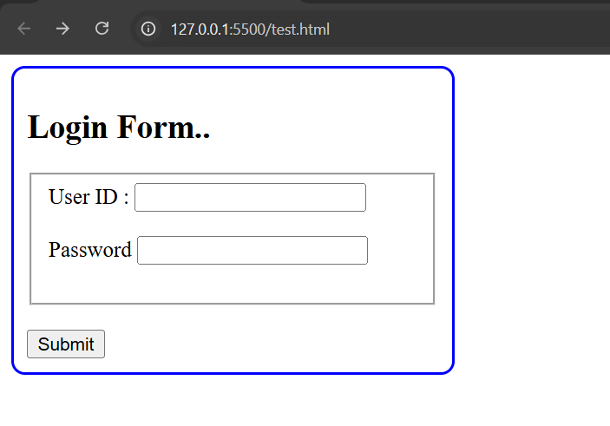
Fieldsets
FieldSet groups the elements :

Slide 43

Tab index
Controls the navigation order of inputs using the Tab key.

Slide 44
Access keys
Assigns a keyboard shortcut to activate a form element. Submit button also can be invoked by Alt+ s.

Slide 45
HTML form scenarios -Scripting forms
JavaScript is often used to validate form inputs, manipulate form elements, and handle form submission dynamically.

Slide 46
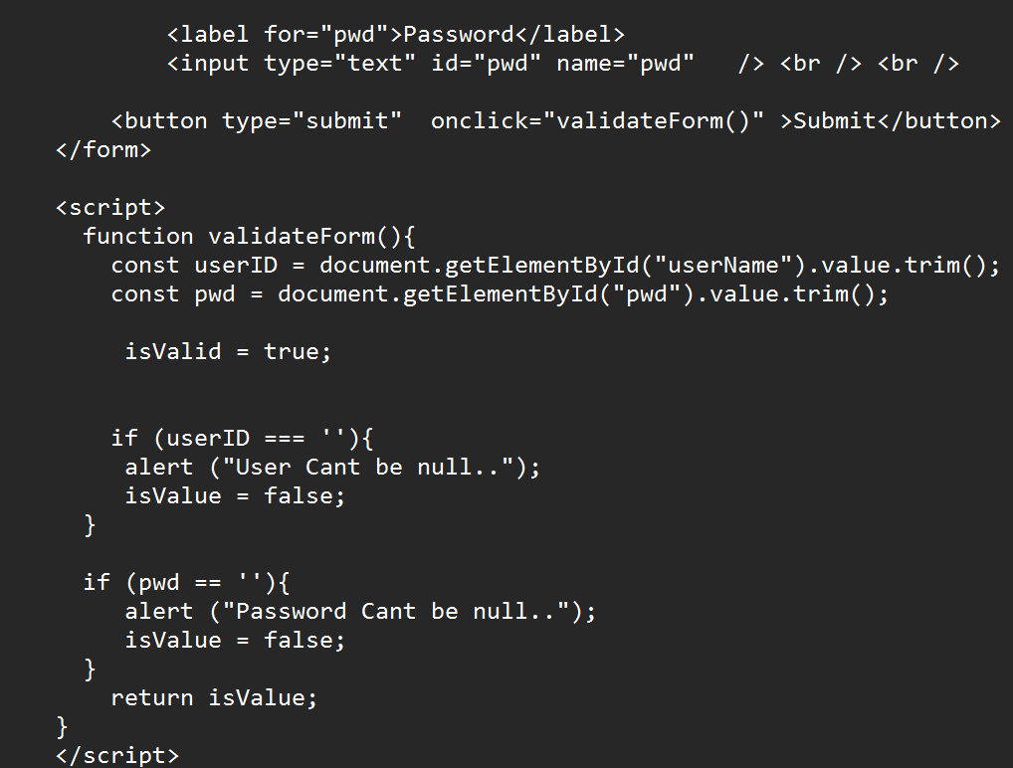
HTML form scenarios -Scripting forms

Slide 47
Handling multiple forms
Handling multiple forms in HTML involves assigning unique identifiers or names to each form and managing them independently in JavaScript. This allows you to perform distinct actions for each form, such as validation or submission.

Slide 48
What’s new in HTML5 - What is HTML5?

Slide 49
New HTML5 Elements

Slide 50
New JavaScript APIs

Slide 51
When is HTML5 Fully Compliant with All Browsers?

Slide 52
Markup Example Before and After HTML5

Slide 53
Detecting HTML5 Features

Slide 54
Semantic HTML - What Is Semantic HTML?

Slide 55
Auditing a Site for Semantic Issues

Slide 56
HTML Outlines -Outlines in HTML4 vs. HTML5

Slide 57
Text-level Semantic Elements

Slide 58
Semantic Forms

Slide 59
Forms - New Input Types?

Slide 60
New Input Types: Markup Review

Slide 61
New Input Types: In Different Browsers to Native Validation

Slide 62
Using the Datalist Tag

Slide 63
Working with Pseudo Classes

Slide 64
Exposing Custom Validation Messages

Slide 65
Native Validation Rules

Slide 66
Custom Validation Rules

Slide 67
Thank you...

